Slide 1

Assessment of zebrafish muscles in vivo by using polarization-sensitive optical coherence tomography
Lida Zhu
Computational Optics Group, University of Tsukuba

Slide 2
Background
Zebrafish model has been used in myopathic studies, due to the high similarity in the structure and genetics compared with humans.
But conventional imaging tools are difficult to detect the details of zebrafish muscle.

Slide 3
Background
 | Label-free | Penetration | Specific contrast
Two-photon microscopy |  |  | ✓
Polarized light microscopy | ✓ |  | ✓
OCT | ✓ | ✓ | 
PS-OCT | ✓ | ✓ | ✓
PS-OCT is a label-free, high resolution, high penetration imaging technique, which also provides polarimetric properties of biological sample.

Slide 4
Purpose
Use high-resolution PS-OCT system for imaging zebrafish in vivo.
Obtain multiple polarization characteristics of different muscles.
Study if polarization characteristics and be used to discern muscles with different composition and fiber orientation

Slide 5
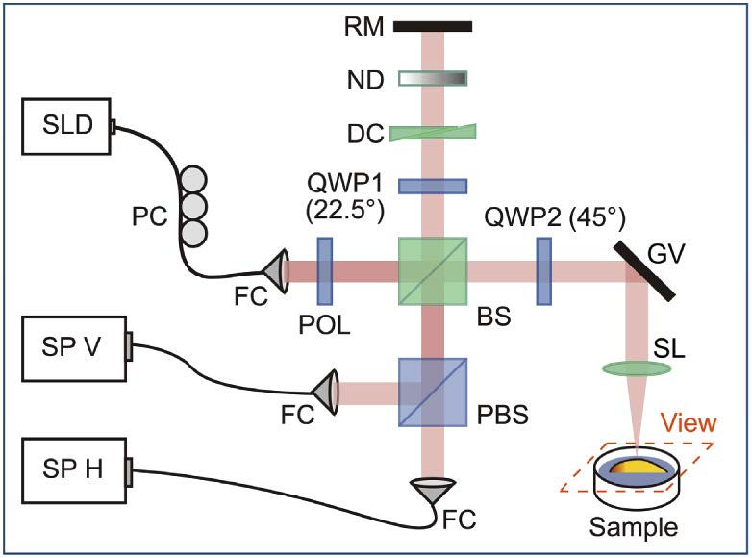
PS-OCT system
Central wavelength: | 840 nm
Bandwidth: | 100 nm
Probe power at sample: | 4 mW
Axial resolution: | 3.4 um
Lateral resolution: | 13 um
Spectrometer line rate: | 25kHz
SLD, superluminescent diode | PC, polarization controller
FC, fiber collimator | POL, linear polarizer
BS, non-polarizing beam splitter | QWP, quarter-wave plate
DC, dispersion compensator | ND, neutral density filter
RM, reference mirror | GV, galvanometer scanning mirror
SL, scanning lens | PBS, polarizing beam splitter
SP, spectrometer
Yang D, Hu M, Zhang M, et al. High-resolution polarization-sensitive optical coherence tomography for zebrafish muscle imaging[J]. Biomedical Optics Express, 2020, 11(10): 5618-5632.

Slide 6

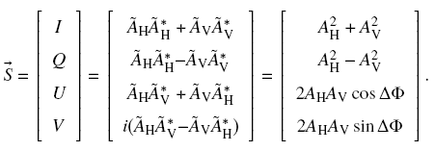
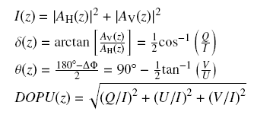


Signal processing
The complex interferometric signals are obtained in horizontal (H) and vertical (V) polarization channels:
The corresponding Stokes vector $\vec{S}$ is given by:
Use Stokes vector averaging to suppress speckle noise
The intensity of reflectivity $I(z)$, accumulative retardation $δ(z)$, accumulative optic axis $θ(z)$, and DOPU are calculated:
Local retardation and local optic axis are converted from local Jones matrix computing and eigen-decomposition

Slide 7
Sample preparation
1. Sample: wild-type zebrafish of strain AB (male, older than 60 days).
2. Anesthetized in a 0.024% tricaine solution by immersion until they
became unresponsive to touch.
(still living)
3. Placed in agar gel filled with 0.012% tricaine solution.
4. Sacrificed after OCT imaging, by using 0.4% tricaine and ice water and
fixed in 4% paraformaldehyde solution.
5. Embedded inside paraffin sections and cut at a thickness of 20 μm. All the
slices were stained with hematoxylin and eosin as imaging references

Slide 8
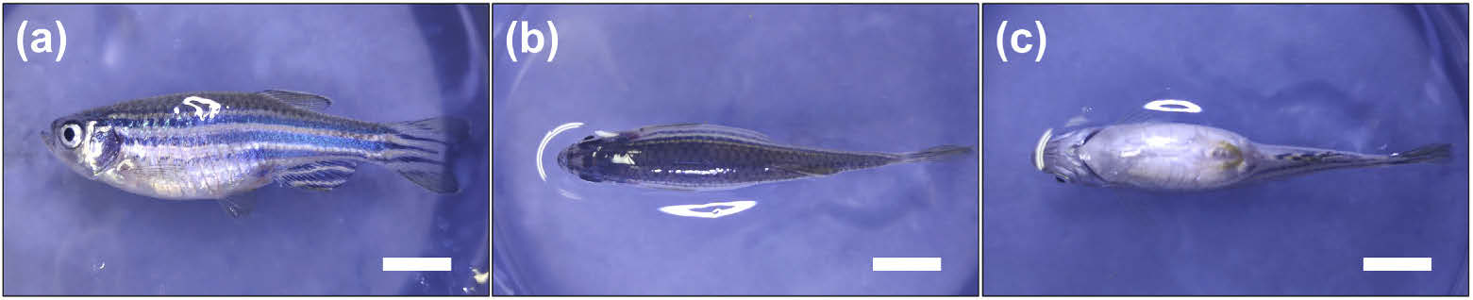
Measurement protocol
Three scanning directions to image all kinds of muscles.
Lateral
Dorsal
Ventral
2 cm
Data size: 2500(X) x 1000(Y) x 2048(Z) pixels
Scanning range: 12.5 mm x 5 mm x 2.3 mm
Scanning time: 2 minutes

Slide 9
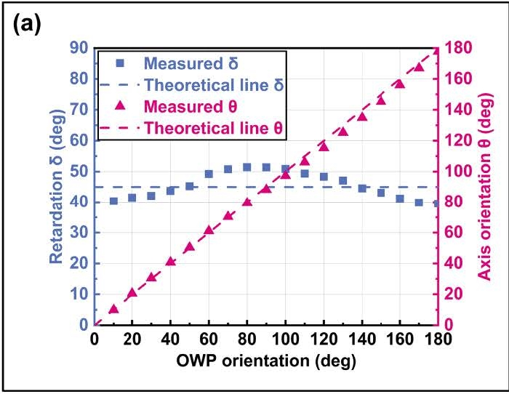
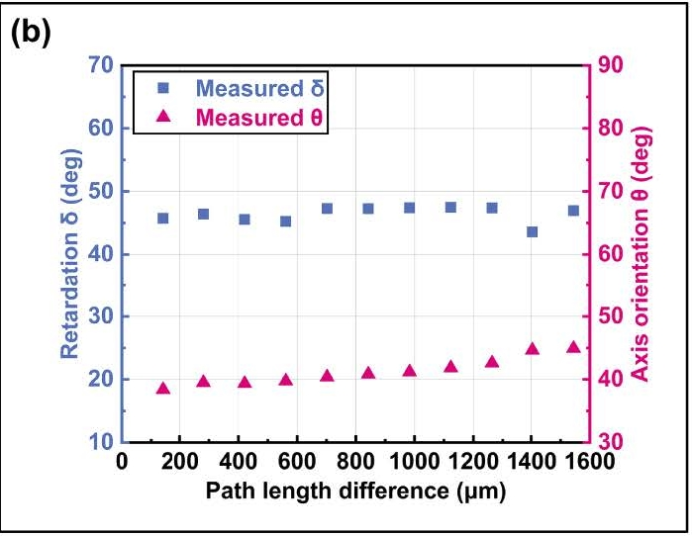
System validation
Accuracy: measuring a rotating OWP
Measure retardation and optic axis orientation by varying the axis orientation of octadic-wave plate (OWP).
Varying range: (0-180 degree)
Result: measured axis orientation is linear to the set OWP orientation.
measured retardation slightly fluctuates around 45 degree.
Accuracy and stability of PS-OCT system has been proved for measurement.
Mean = 45.51°; STD = 4.31 °
Stability: measuring a moving OWP along depth
Measure a moving OWP by varying the path length difference between sample and reference arm.
Varying range: (0.1-1.6 mm)
Result: measured axis orientation and retardation are almost constant.
slight drift of axis orientation may be caused by signal attenuation.
Optic axis orientation:
Mean = 41.22°; STD = 2.13°
Retardation:
Mean = 46.38°; STD = 1.25°

Slide 10
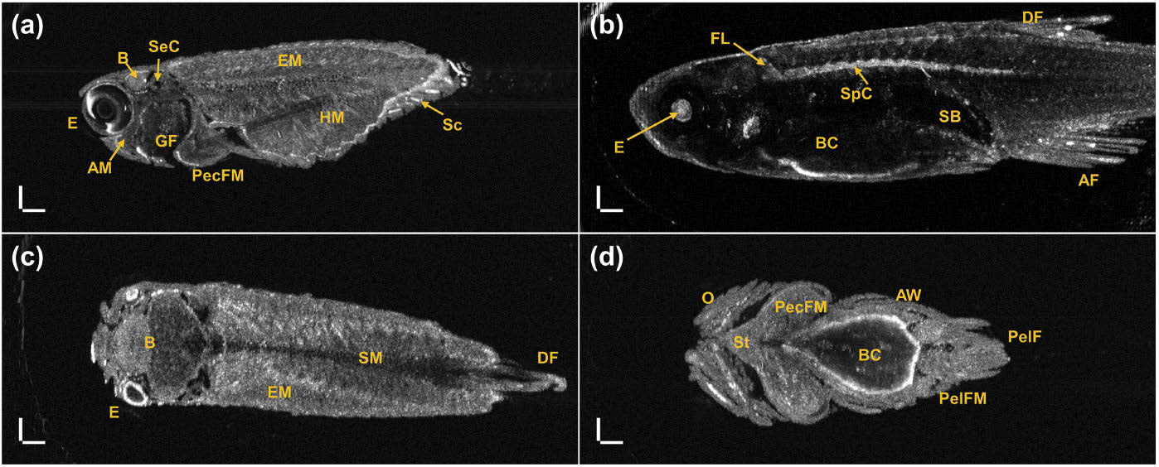
Results
Lateral scanning (shallower)
Lateral scanning (deeper)
500 um
Dorsal scanning
Ventral scanning
Lateral scanning (a), (b):
eye (E),
brain (B),
semicircular canal (SeC),
gill filaments (GF),
pectoral fin muscle (PecFM),
facial lobe (FL),
dorsal fin (DF),
anal fin (AF),
epaxial muscles (EM),
hypaxial muscles (HM),
spinal cord (SpC)
body cavity (BC).
Dorsal and ventral scanning (c), (d):
brain and supracarinate muscles (SM),
sternohyoid (St),
pectoral fin muscle (PecFM),
pelvic fin muscle (PelFM),
pelvic fin (PelF)
abdominal wall (AW)
Penetration depth and imaging quality of PS-OCT system is confirmed visually.

Slide 11
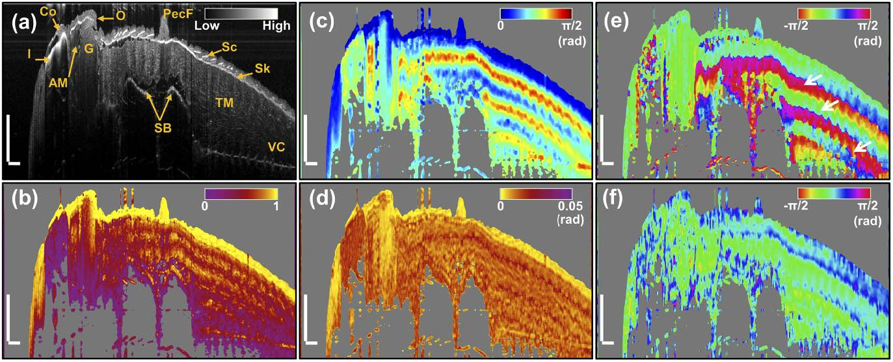
Results
Intensity
Accumulative retardation
Accumulative optic axis
Structures in intensity image (a):
iris (I),
cornea (Co),
adductor mandibulae (AM),
opercle (O),
gill (G),
pectoral fin (PecF),
scales (Sc),
skin (Sk),
trunk musculature (TM),
swim bladder (SB)
vertebral column (VC).
500 um
DOPU
Local retardation
Local optic axis
High and homogeneous DOPU in pectoral fin and skin
Low birefringence in pectoral fin and skin
High birefringence in trunk musculature (due to different collagen contents)
Misleading phase jump
Pectoral fin, skin | Trunk musculature
Higher DOPU Lower birefringence | Lower DOPU Higher birefringence

Slide 12
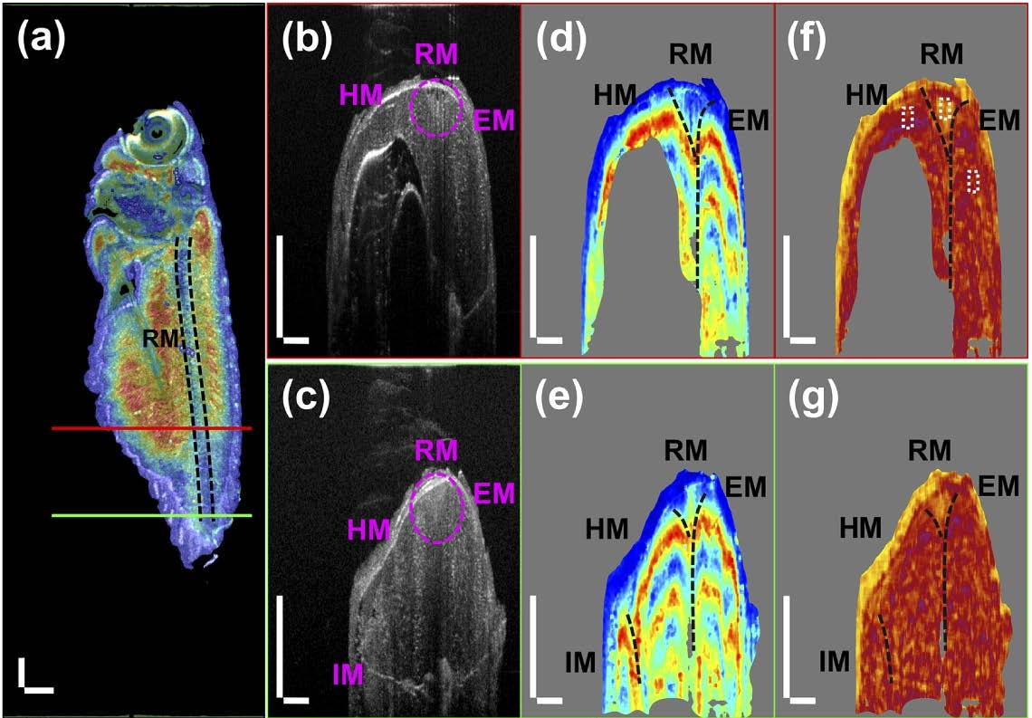
Birefringence analysis in lateral scanning
Distinguishing between red and white muscle
Accumulative retardation
Red muscle (RM):
More lipid → lower birefringence
Intensity
Local retardation
White muscle
(epaxial muscles (EM) and hypaxial muscles (HM)):
Less lipid → lower birefringence
Intensity images (b), (c):
Easy to identify the infracarinate muscles (IM)
But the white muscle (epaxial muscles (EM) and hypaxial muscles (HM)) cannot be distinguished from RM;
Accumulative retardation
Accumulative retardation images (d), (e):
White muscle and red muscle areas can be clearly discerned (black dashed curves)
500 um
Local retardation images (d), (e):
RM shows lower birefringence than white muscle
Quantitative birefringence analysis:
select a region including 30x80 pixels (0.16 mm x 0.1 mm) from RM, HM, and EM (marked by white dashed boxes)

Slide 13
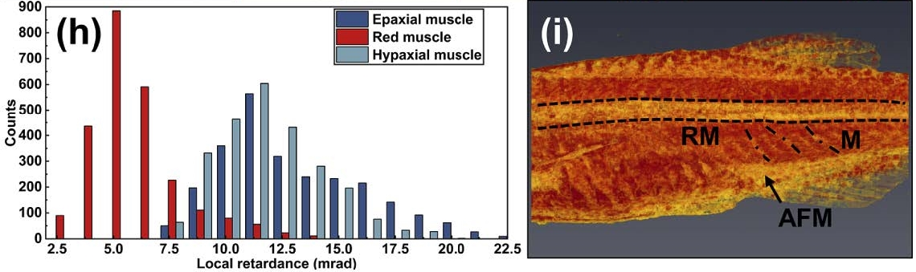
Birefringence analysis in lateral scanning
Distinguishing between red and white muscle
Histogram in selected regions in RM, EM, and HM
3D rendering of local retardation
In general, local retardation of RM is lower than EM and HM
Birefringence of white muscle is calculated to be 0.0011
RM clearly observed in local retardation image
RM, anal fin musculature (AFM), and myoseptum (M) show low birefringence
Local retardation (birefringence) image can be used to distinguish red muscle from white muscle.

Slide 14
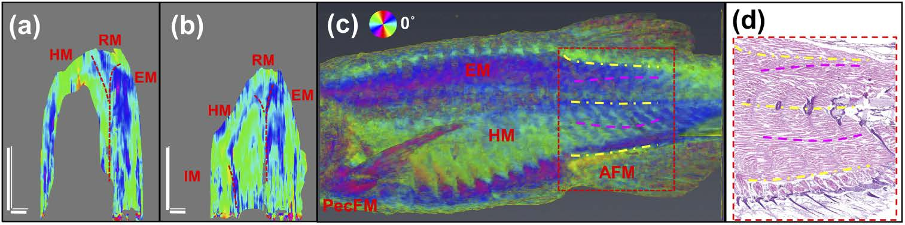
Local optics axis analysis in lateral scanning
Fiber orientation
500 um
Distribution of local optic axis is not uniform in EM and HM areas.
3D rendering image of local optic axis shows different local optic axis patterns in EM and the HM.
Histology image confirms the different muscle fiber orientation patterns.
Local optic axis image can be used to identify the muscle fiber orientation.

Slide 15
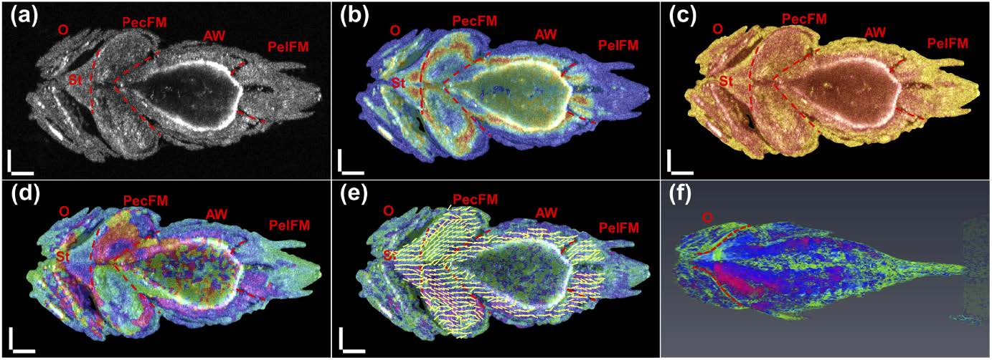
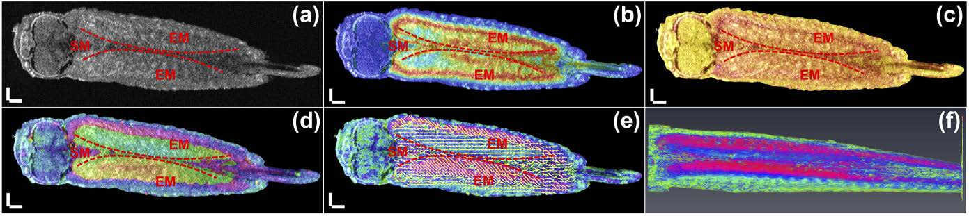
Results from ventral and dorsal scanning
Other views of SM and IM
Ventral scanning
Dorsal scanning
Intensity
Accumulative retardation
Local retardation
Accumulative optics axis
Local optics axis overlayed with streamline diagram
3D rendering of local optics axis
opercle (O),
sternohyoid (St),
pectoral fin muscle (PecFM),
abdominal wall (AW),
pelvic fin muscle (PelFM),
epaxial muscles (EM)
supracarinate muscles (SM)
infracarinate muscles (IM)
Symmetry along the sagittal central axis
Intensity:
Show the symmetry of the bilateral organ structure.
Accumulative/local retardation:
Show the symmetrical birefringence of the bilateral muscles;
Local retardation values of muscles are larger than those of the skin and fins.
Accumulative/local optic axis:
Show the symmetrical orientation of bilateral muscle fibers.

Slide 16
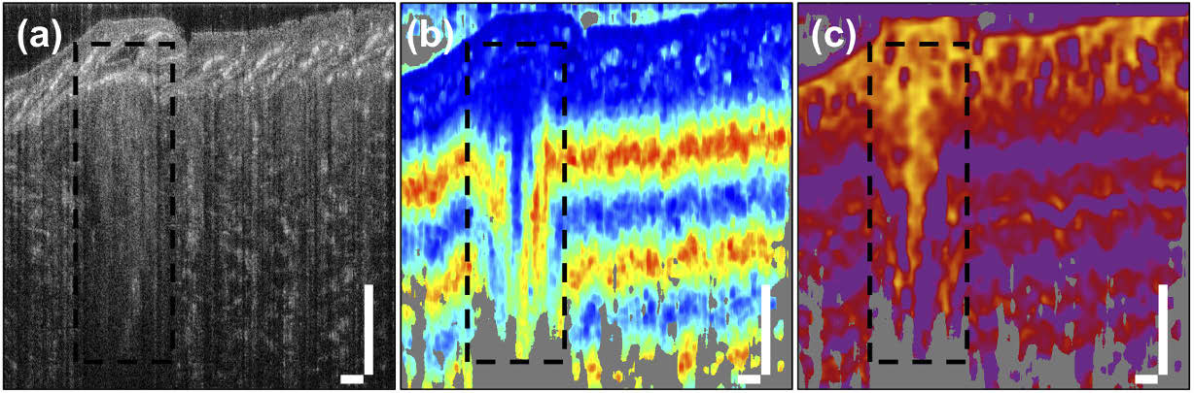
Results of injured zebrafish
Variation of muscles
250 um
Intensity
Accumulative retardation
Local retardation
Sample: zebrafish stabbed in trunk muscle
Intensity:
Injured area has less muscle texture than adjacent muscle tissue
Accumulative retardation:
The change of the accumulative retardation tends to be flat in the injured area
Local retardation:
Injured area gives a low birefringence
Indicate the injury of muscle could cause the disappearance of its birefringence.

Slide 17
Conclusion
Summary
High-resolution PS-OCT system can be used for imaging various muscles of zebrafish.
Quantitative birefringence assessment of zebrafish muscle, and the mapping relationship between the local optic axis and the muscle fiber orientation can be used for discerning different muscles.
PS-OCT system can detect the variation of muscle.
Conclusion
High-resolution PS-OCT has great potential in studying zebrafish muscle models

